Slide 1
AUBot A Machine Learning Wonder
By: Fatima Ghadieh
Amine Ghoussaini
Ali Hijjawi

Slide 2
Table of Contents
Problem Definition
The Dataset
Preprocessing Procedure
Model Description
Issues Faced
Solutions Done
Experimental Results
Insight of Experiment
Conlcusion

Slide 3
1. Problem Definition
What our project is for.

Slide 4
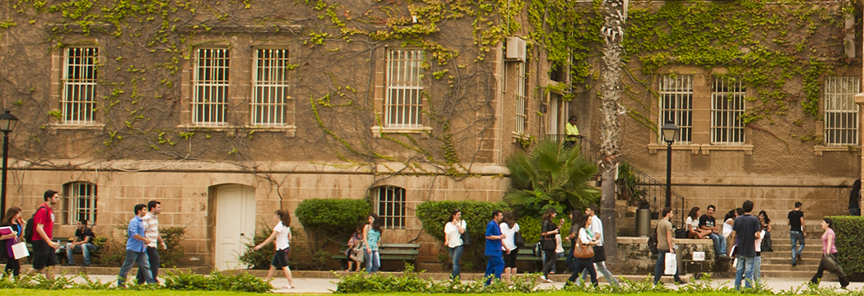
Problem Importance
With the ongoing struggle of new students entering AUB and the little help and consideration the overwhelmed students get, a friendly Chatbot had to be done to ease up their stress.

Slide 5
Project Challenges
Chatbot might fail to correctly recognize similar questions if they were phrased differently
Chatbot might stumble across a question that is not enfolded by its knowledge base.
Some problems encountered by students can also be too complex for the chatbot to be able to answer.

Slide 6
How can we build the chatbot to successfully and as accurately as possible build a bridge between a student’s inquiry and the answer they are seeking using predetermined statements with known answers and linking potential new questions to the initial set of questions?
Main Question:

Slide 7
Context
preprocessing
User Message
Predetermined Responses
English Sentence
N Unique Intent Classes
Retrieval-based model
N dimensional
one hot encoded vector
that indicates the predicted label
Response
English Sentence

Slide 8
2. The Dataset
Our training data.

Slide 9
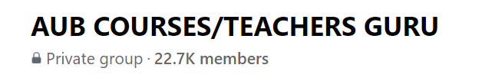
Dataset Format
The dataset is a JSON file formed of 415 questions and responses in the following format:
{
"tag": "Financial Aid Application Date",
"patterns": [
"When can I apply for financial aid? ",
"When can I start applying for financial aid? ",
"When do I apply for financial aid for this year?"
],
"responses": [
"The online application for AY 2020-21 will be available starting February 10, 2020."
]
}
Questions were scraped using a web parser from the group:
patterns: training examples each class; responses: what the chatbot should output as an answer.

Slide 10
3. Preprocessing Procedure
Handling the data.

Slide 11
Fixing the Data
Data Preprocessing was performed through the following procedure:
Question:
What is the procedure for fulfilling a minor?
Tokenization: ['What', 'is', 'the', 'procedure', 'for', 'fulfilling', 'a', 'minor', '?’]
Stemming:
['what', 'is', 'the', 'proc', 'for', 'fulfil', 'a', 'min']
One hot encoding:
[1 0 0 0 0 1 0 1 0 0 0 1 1 1 1 0 1 0]

Slide 12
4. Methodology
Building the models.

Slide 13
Experimental Assumptions
The student speaks in formal English that is free of any spelling or logical errors
The student does not ask questions outside the scope of the chatbot’s knowledge
The student is expected to send one request at a time in a simple straightforward manner

Slide 14
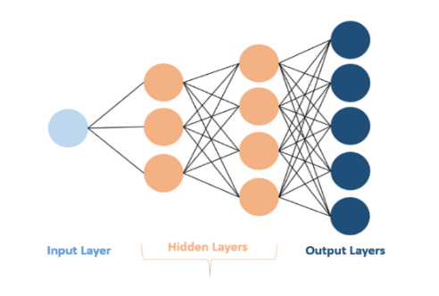
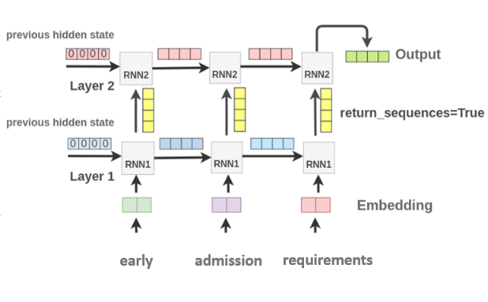
The Models
DNN Model:
LSTM Model:
Deep Neural Network: uses a one-hot encoding over a series of layers and nodes
Long Short-Term Memory: uses word embeddings and each sequential state depends on previous ones

Slide 15
Model Architectures
DNN | LSTM
7 Layers | 5 Layers
200 – 1200 Neurons per layer | 30 – 350 Neurons per layer
ReLu & SoftMax Activation Functions | SoftMax Activation Function
Adam Optimizer | Adam Optimizer
Categorical cross entropy | Loss: Cosine Similarity

Slide 16
5. Issues Faced
Problems in the models.

Slide 17
Problems Faced & Their Solutions
Data Collection and Organization
Model Accuracy for a small dataset
Model Accuracy for an augmented dataset
Web Parsing Tool for data collection
Manual elimination of irrelevant questions
Storing data in a json file
Increasing number of epochs
Tuning the models by adjusting number of layers and neurons
Augmenting the data by adding more training examples

Slide 18
6. Experimental Results
Model accuracy and loss metrics.

Slide 19
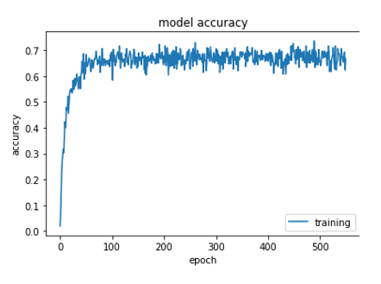
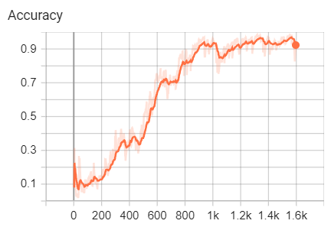
Accuracy Curves
LSTM Model
DNN Model
Lower Accuracy
Faster learning rate
Curve is more stable
Higher Accuracy
Slower learning rate
Curve fluctuates more

Slide 20
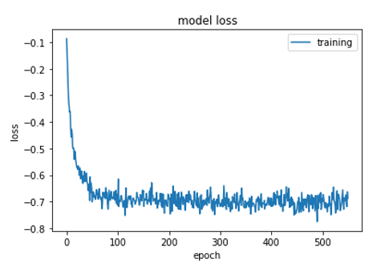
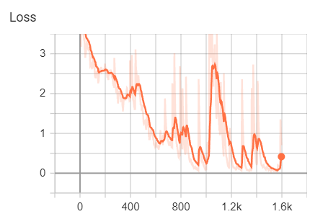
Loss Curves
LSTM Model
DNN Model
Lower loss value
Curve is more stable
Higher loss
Curve fluctuates more

Slide 21
DNN Chatbot in Action
Answer is in green if answered correctly
Start talking with AUBot (type quit to stop)!
You: what's up?
AUBot: Hi there, how can I help?
You: how are you doing?
AUBot: I am doing just fine. Please ask me some question.
You: what's your name?
AUBot: You can call me AUBot.
You: what are you?
AUBot: I can answer AUB related questions relevant to transcripts, financial aid, capacities, petitions, registration, transfer, and work study.
You: What does a negative value mean on the web statement of fees?
AUBot: It is for financial aid, what you have removed. The statement will update later.
You: does financial aid cover the summer semester?
AUBot: Engineering students can only benefit from financial aid during the summer semester

Slide 22
You: when does the registrar open?
AUBot: Registrar, Cashier and Comptroller's offices are from 8 a.m. to 4 p.m. M-F outside of holidays.
You: how do I submit a petition?
AUBot: Google 'aub petitions' and it should be the first link you see
You: my web statement of fees is not updated although i payed
AUBot: Check with the Comptroller's at AUB College hall. Usually take a week to update.
You: how do I get payment from the work study program?
AUBot: Currently, they are giving from 13,000 to 16,000 L.L per hour, usually either to remove from tuition, or to get it cash. Some jobs have more money but you get them removed from tuition.
You: where can I find the financial aid application?
AUBot: when you ask for an application and receive the mail for it, you would have 30 days to complete it.
You: where can I see my financial aid result?
AUBot: Go to aubsis, press the last tab in the middle "Student Awards and Financial Aid", and then 'view my student aid'. it should be there.
You: when does jafet library open?
AUBot: Jafet Library Computer labs and Reading areas are open Monday - Friday: 07:30 AM - 09:00 PM, Saturday: 08:00 AM - 05:00 PM, Sunday: Noon - 08:00 PM

Slide 23
You: when are the opening hours of the gym?
AUBot: CHSC opening hours are Monday to Friday from 7:00am till 7:00pm and Saturday from 9am till 5pm. Note that the gym is closed on Sundays.
You: okay thank you
AUBot: You are very welcome.
You: have a good day
AUBot: have a good one
You: quit

Slide 24
7. Insights of Experiment & Conclusion
Views on the results and final thoughts.

Slide 25
Experimental Insight
Both the models were giving correct answers most of the times, but the DNN model performed much better than the LSTM one. The Simplicity of the DNN helped bring this result.
Project Conclusions
With the DNN model outperforming the LSTM one, and with the relative simplicity of the project goal, we would like to enhance the DNN model in hopes of releasing it for practical use.

